Slide 1
Oligopoly & An Introduction to Game Theory
PPT – 15
Industrial Economics
(Prepared as a Self – Study Topic)

Slide 2
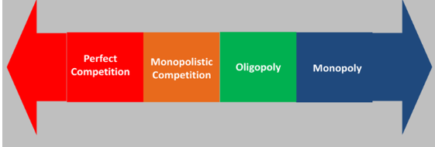
OLIGOPOLY

Slide 3
What Is An Oligopoly?
4th type of market structure that exists within an economy
In an oligopoly, there is a small number of firms that control the market.
A key characteristic of an oligopoly is that none of these firms can keep the others from having significant influence over the market.
The concentration ratio measures the market share of the largest firms.
There is no precise upper limit to the number of firms in an oligopoly, but the number must be low enough that the actions of one firm significantly influence the others.
An oligopoly is different from a monopoly, which is a market with only one producer.

Slide 4
Firms in an oligopoly set prices, whether collectively—in a cartel—or under the leadership of one firm, rather than taking prices from the market. Profit margins are thus higher than they would be in a more competitive market.
Some of the barriers to entry (that prevent new players from entering the market) in an oligopoly include economies of scale, regulatory barriers, accessing supply and distribution channels, capital requirements, and brand loyalty.
Oligopolies in history include steel manufacturers, oil companies, railroads, tire manufacturing, grocery store chains, and wireless carriers.
The economic and legal concern is that an oligopoly can block new entrants, slow innovation, and increase prices, all of which can harm consumers.

Slide 5
Oligopoly Characteristics
Price-fixing - Price-fixing is the act of setting prices, rather than letting them be determined by the free-market forces.
Another approach is for firms to follow a recognized price leader so that when the leader raises prices, the others will follow.
The conditions that enable oligopolies to exist include high entry costs in capital expenditures, legal privilege (license to use wireless spectrum or land for railroads), and a platform that gains value with more customers, such as social media.

Slide 6
Advantages And Disadvantages Of An Oligopoly
Advantages:
One of the main benefits of having an oligopoly is that competition is very limited. That's because there are very few players in the market. Since there are few competitors, an oligopoly allows those who participate to net a higher amount of profits.
Customer demand is often greater in this type of market structure. This is commonly due to the fact that there are better products and services that are on the market. As such, firms don't skimp on quality as they want to retain or increase brand loyalty.
Customers can expect better customer service and better pricing for products and services from the firms in an oligopoly because of the small number of participants.

Slide 7
Disadvantages:
Oligopolies come with higher barriers to entry for new participants. This means that it can be difficult to enter the market because of the high costs associated with doing business, the regulatory environment, and the problems that arise when it comes to accessing supply and distribution channels.
Because of the lack of competition, there may be very little incentive to innovate product and service offerings. With no diversity in offerings, consumers remain loyal to what they know best.
Although there may be more quality products on the market, consumers often have little choice available to them. This means they can only rely on a small pool of goods and services on which to spend their money.

Slide 8
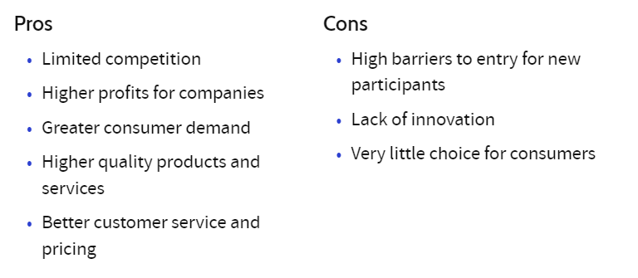

Slide 9
Example for a Global Oligopoly: OPEC
There are many examples of oligopolies in the market. But one of the major examples of a global oligopoly is the Organization of the Petroleum Exporting Countries (OPEC).
The organization was founded in Baghdad in 1960 with five countries but expanded to 13 oil-producing countries in 1975.
One of the main reasons why OPEC is considered an oligopoly is because it has no overarching authority. Every member nation within the group also has a substantial portion of the group's market share.
These countries also have a great deal of power together (not separately) when it comes to supply and demand issues and pricing. So when the group lowers its supply as demand drops, prices rise. The opposite is true when demand rises.

Slide 10
Concentration Ratio
One measure that shows if an oligopoly is present is the concentration ratio, which calculates the size of companies in comparison to their industry.
Instances where a high concentration ratio is present include mass media. In the U.S., for example, the sector is dominated by just five companies: NBC Universal; Walt Disney; Time Warner; Viacom CBS; and News Corporation—even as streaming services like Netflix and Amazon Prime begin to encroach on this market.
Meanwhile, within big tech, two companies control smartphone operating systems: Google Android and Apple iOS.
Concentration Ratio – The combined percentage of total industry output accounted for by the largest producers in the industry.

Slide 11
Collusive Oligopoly
Oligopoly: Competition vs. Co-operation
Group of producers come together to collectively increase profit.
Cartels aiming at joint profit maximization.
Market sharing cartels
This is most common and popular. Eg.: OPEC
More freedom on the style of their output, their selling activities .
Non-competitive agreements.
Non–Collusive Oligopoly – situation where the firms compete with each other rather than cooperating.
Indian telecom market – the fierce competition among the four telecom firms: Jio, Airtel, Vodafone-Idea, and BSNL.

Slide 12
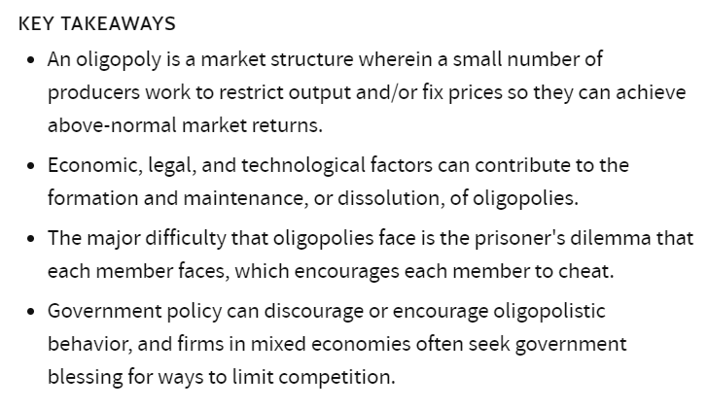

Slide 13
An Introduction to Game Theory

Slide 14
Link with Oligopoly
Oligopoly - a market structure in which only a few sellers offer similar or identical products
The essence of an oligopolistic market is that there are only a few sellers.
As a result, the actions of any one seller in the market can have a large impact on the profits of all the other sellers.
Oligopolistic firms are interdependent in a way that competitive firms are not.
Our goal is to see how this interdependence shapes the firms’ behavior and what problems it raises for public policy.

Slide 15
Game Theory
Game Theory - the study of how people behave in strategic situations
The analysis of oligopoly offers an opportunity to introduce game theory, the study of how people behave in strategic situations. By “strategic” we mean a situation in which a person, when choosing among alternative courses of action, must consider how others might respond to the action she takes.
Strategic thinking is crucial in many business decisions. Because oligopolistic markets have only a small number of firms, each firm must act strategically.
Each firm knows that its profit depends not only on how much it produces but also on how much the other firms produce. In making its production decision, each firm in an oligopoly should consider how its decision might affect the production decisions of all the other firms in the market.

Slide 16
Markets with Only a Few Sellers
Because an oligopolistic market has only a small group of sellers, a key feature of oligopoly is the tension between cooperation and self-interest.
The oligopolists are best off when they cooperate and act like a monopolist—producing a small quantity of output and charging a price above marginal cost.
Yet because each oligopolist cares only about its own profit, there are powerful incentives at work that hinder a group of firms from maintaining the cooperative outcome.

Slide 17
A Duopoly Example
To understand the behavior of oligopolies, let’s consider an oligopoly with only two members, called a duopoly. Duopoly is the simplest type of oligopoly.
Oligopolies with three or more members face the same problems as duopolies, so we do not lose much by starting with the simpler case.
Imagine a town in which only two residents—Jack and Jill—own wells that produce water safe for drinking. Each Saturday, Jack and Jill decide how many gallons of water to pump, bring the water to town, and sell it for whatever price the market will bear. To keep things simple, suppose that Jack and Jill can pump as much water as they want without cost. That is, the marginal cost of water equals zero.

Slide 18
Table 1 shows the town’s demand schedule for water. The first column shows the total quantity demanded, and the second column shows the price.
The last column in Table 1 shows the total revenue from the sale of water. It equals the quantity sold times the price. Since we assumed there is no cost to pumping water, the total revenue of the two producers equals their total profit.
Let’s now consider how the organization of the town’s water industry affects the price of water and the quantity of water sold.

Slide 19
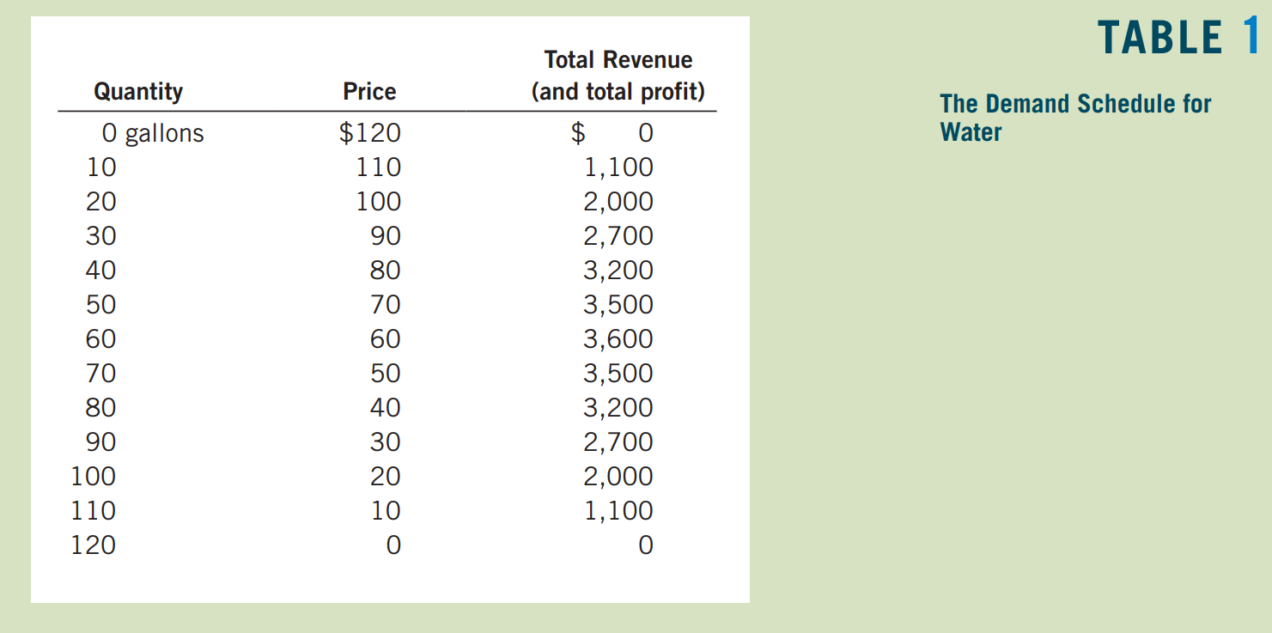

Slide 20
Cartels
What would be the price and quantity of water that would result from the duopoly of Jack and Jill..?
One possibility is that Jack and Jill get together and agree on the quantity of water to produce and the price to charge for it. Such an agreement among firms over production and price is called collusion, and the group of firms acting in unison is called a cartel.
Once a cartel is formed, the market is in effect served by a monopoly.
That is, if Jack and Jill were to collude, our two producers would produce a total of 60 gallons, which would be sold at a price of $60 a gallon. Once again, price exceeds marginal cost, and the outcome is socially inefficient.

Slide 21
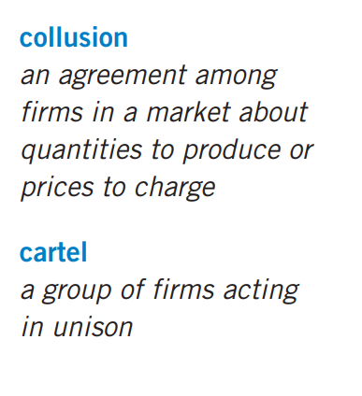
A cartel must agree not only on the total level of production but also on the amount produced by each member.
In our case, Jack and Jill must agree on how to split the monopoly production of 60 gallons.
Each member of the cartel will want a larger share of the market because a larger market share means larger profit.
If Jack and Jill agreed to split the market equally, each would produce 30 gallons, the price would be $60 a gallon, and each would get a profit of $1,800.

Slide 22
The Equilibrium for an Oligopoly
Oligopolists would like to form cartels and earn monopoly profits, but that is often impossible. Squabbling among cartel members over how to divide the profit in the market can make agreement among members difficult.
In addition, antitrust laws prohibit explicit agreements among oligopolists as a matter of public policy. Even talking about pricing and production restrictions with competitors can be a criminal offense.
So, let’s consider what happens if Jack and Jill decide separately how much water to produce.
If the duopolists individually pursue their own self-interest when deciding how much to produce, they produce a total quantity greater than the monopoly quantity, charge a price lower than the monopoly price, and earn total profit less than the monopoly profit.

Slide 23
At first, one might expect Jack and Jill to reach the monopoly outcome on their own, because this outcome maximizes their joint profit. In the absence of a binding agreement, however, the monopoly outcome is unlikely.
To see why, imagine that Jack expects Jill to produce only 30 gallons (half of the monopoly quantity). Jack would reason as follows: “I could produce 30 gallons as well. In this case, a total of 60 gallons of water would be sold at a price of $60 a gallon. My profit would be $1,800 (30 gallons × $60 a gallon). Alternatively, I could produce 40 gallons. In this case, a total of 70 gallons of water would be sold at a price of $50 a gallon. My profit would be $2,000 (40 gallons × $50 a gallon). Even though total profit in the market would fall, my profit would be higher, because I would have a larger share of the market.”
Of course, Jill might reason the same way. If so, Jack and Jill would each bring 40 gallons to town. Total sales would be 80 gallons, and the price would fall to $40.
Although the logic of self-interest increases the duopoly’s output above the monopoly level, it does not push the duopolists all the way to the competitive allocation.
Consider what happens when each duopolist produces 40 gallons. The price is $40, and each duopolist makes a profit of $1,600. In this case, Jack’s self-interested logic leads to a different conclusion: “Right now, my profit is $1,600. Suppose I increase my production to 50 gallons. In this case, a total of 90 gallons of water would be sold, and the price would be $30 a gallon. Then my profit would be only $1,500. Rather than increasing production and driving down the price, I am better off keeping my production at 40 gallons.”

Slide 24
Nash Equilibrium
The outcome in which Jack and Jill each produce 40 gallons looks like some sort of equilibrium. In fact, this outcome is called a Nash equilibrium. (It is named after economic theorist John Nash, whose life was portrayed in the book and movie A Beautiful Mind.)
A Nash equilibrium is a situation in which economic actors interacting with one another each choose their best strategy given the strategies the others have chosen.
In this case, given that Jill is producing 40 gallons, the best strategy for Jack is to produce 40 gallons. Similarly, given that Jack is producing 40 gallons, the best strategy for Jill is to produce 40 gallons. Once they reach this Nash equilibrium, neither Jack nor Jill has an incentive to make a different decision.

Slide 25
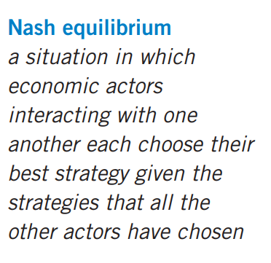
This example illustrates the tension between cooperation and self-interest.
Oligopolists would be better off cooperating and reaching the monopoly outcome. Yet because they pursue their own self-interest, they do not end up reaching the monopoly outcome and maximizing their joint profit.
Each oligopolist is tempted to raise production and capture a larger share of the market. As each of them tries to do this, total production rises, and the price falls.

Slide 26
At the same time, self-interest does not drive the market all the way to the competitive outcome.
Like monopolists, oligopolists are aware that increasing the amount they produce reduces the price of their product, which in turn affects profits. Therefore, they stop short of following the competitive firm’s rule of producing up to the point where price equals marginal cost.
In summary, when firms in an oligopoly individually choose production to maximize profit, they produce a quantity of output greater than the level produced by monopoly and less than the level produced by perfect competition. The oligopoly price is less than the monopoly price but greater than the competitive price (price would be greater than marginal cost, but not as high as in a monopoly).

Slide 27
How the Size of an Oligopoly Affects the Market Outcome…?
How would an increase in the number of sellers from two to four affect the price and quantity of water in the town?
The demand schedule in Table 1 remains the same, but now more producers are available to satisfy this demand.
If the sellers of water could form a cartel, they would once again try to maximize total profit by producing the monopoly quantity and charging the monopoly price. Just as when there were only two sellers, the members of the cartel would need to agree on production levels for each member and find some way to enforce the agreement.
As the cartel grows larger, however, this outcome is less likely. Reaching and enforcing an agreement becomes more difficult as the size of the group increases.
If the oligopolists do not form a cartel—perhaps because the antitrust laws prohibit it—they must each decide on their own how much water to produce.

Slide 28
To see how the increase in the number of sellers affects the outcome, consider the decision facing each seller. At any time, each well owner has the option to raise production by one gallon. In making this decision, the well owner weighs the following two effects:
The output effect: Because price is above marginal cost, selling one more gallon of water at the going price will raise profit.
The price effect: Raising production will increase the total amount sold, which will lower the price of water and lower the profit on all the other gallons sold.
If the output effect is larger than the price effect, the well owner will increase production. If the price effect is larger than the output effect, the owner will not raise production. (In fact, in this case, it is profitable to reduce production.)
Each oligopolist continues to increase production until these two marginal effects exactly balance, taking the other firms’ production as given.

Slide 29
The larger the number of sellers, the less each seller is concerned about her own impact on the market price. That is, as the oligopoly grows in size, the magnitude of the price effect falls. When the oligopoly grows very large, the price effect disappears altogether.
That is, the production decision of an individual firm no longer affects the market price.
In this extreme case, each firm takes the market price as given when deciding how much to produce. It increases production as long as price is above marginal cost.
As the number of sellers in an oligopoly grows larger, an oligopolistic market looks more and more like a competitive market. The price approaches marginal cost, and the quantity produced approaches the socially efficient level.

Slide 30
This analysis of oligopoly offers a new perspective on the effects of international trade.
Imagine that Toyota and Honda are the only automakers in Japan, Volkswagen and BMW are the only automakers in Germany, and Ford and General Motors are the only automakers in the United States.
If these nations prohibited international trade in autos, each would have an auto oligopoly with only two members, and the market outcome would likely depart substantially from the competitive ideal.
With international trade, however, the car market is a world market, and the oligopoly in this example has six members.
Allowing free trade increases the number of producers from which each consumer can choose, and this increased competition keeps prices closer to marginal cost.
Thus, the theory of oligopoly provides a reason to why all countries can benefit from free trade.

Slide 31
The Economics of Cooperation
As we have seen, oligopolies would like to reach the monopoly outcome. Doing so, however, requires cooperation, which at times is difficult to establish and maintain.
In this section we look more closely at the problems that arise when cooperation among actors is desirable but difficult. To analyze the economics of cooperation, we need to learn a little about game theory.
In particular, we focus on a “game” called the prisoners’ dilemma, which provides insight into why cooperation is difficult. Many times in life, people fail to cooperate with one another even when cooperation would make them all better off. An oligopoly is just one example. The story of the prisoners’ dilemma contains a general lesson that applies to any group trying to maintain cooperation among its members.

Slide 32
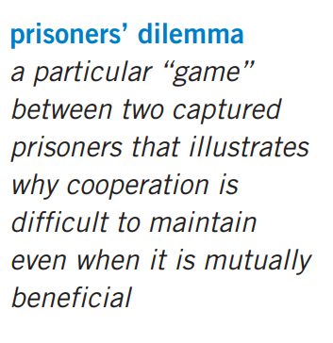
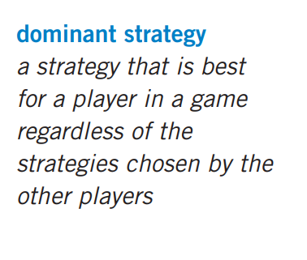

Slide 33
The Prisoners’ Dilemma
The prisoners’ dilemma is a story about two criminals who have been captured by the police. Let’s call them Bonnie and Clyde. The police have enough evidence to convict Bonnie and Clyde of the minor crime of carrying an unregistered gun, so that each would spend a year in jail.
The police also suspect that the two criminals have committed a bank robbery together, but they lack hard evidence to convict them of this major crime. The police question Bonnie and Clyde in separate rooms and offer each of them the following deal:
“Right now, we can lock you up for 1 year. If you confess to the bank robbery and implicate your partner, however, we’ll give you immunity and you can go free. Your partner will get 20 years in jail. But if you both confess to the crime, we won’t need your testimony and we can avoid the cost of a trial, so you will each get an intermediate sentence of 8 years.”
If Bonnie and Clyde, heartless bank robbers that they are, care only about their own sentences, what would you expect them to do? Figure 1 shows their choices. Each prisoner has two strategies: confess or remain silent. The sentence each prisoner gets depends on the strategy he or she chooses and the strategy chosen by his or her partner in crime.

Slide 34
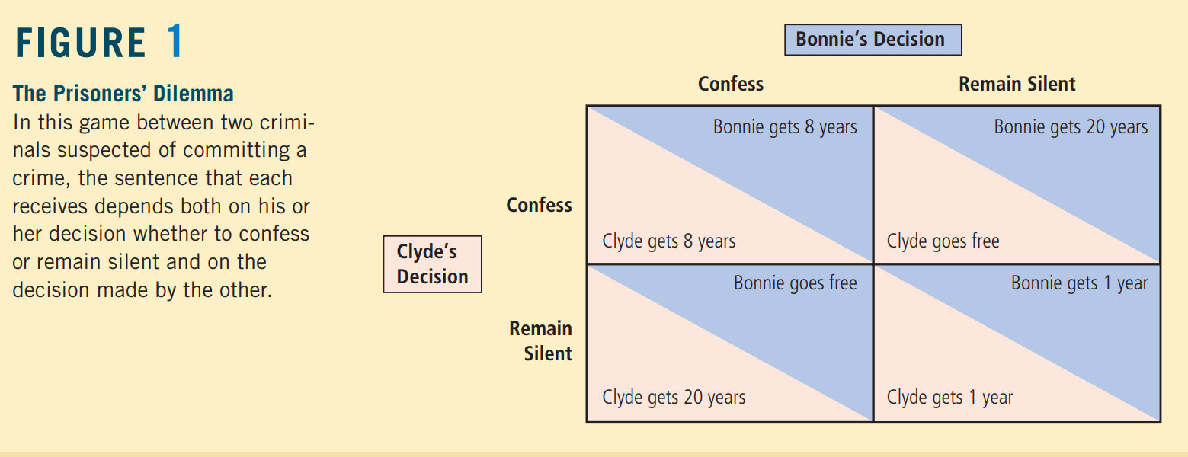

Slide 35
Consider first Bonnie’s decision. She reasons as follows: “I don’t know what Clyde is going to do. If he remains silent, my best strategy is to confess, since then I’ll go free rather than spending a year in jail. If he confesses, my best strategy is still to confess, since then I’ll spend 8 years in jail rather than 20. So, regardless of what Clyde does, I am better off confessing.”
In the language of game theory, a strategy is called a dominant strategy if it is the best strategy for a player to follow regardless of the strategies pursued by other players. In this case, confessing is a dominant strategy for Bonnie. She spends less time in jail if she confesses, regardless of whether Clyde confesses or remains silent.
Now consider Clyde’s decision. He faces the same choices as Bonnie, and he reasons in much the same way. Regardless of what Bonnie does, Clyde can reduce his jail time by confessing. In other words, confessing is also a dominant strategy for Clyde.

Slide 36
In the end, both Bonnie and Clyde confess, and both spend 8 years in jail. This outcome is a Nash equilibrium: Each criminal is choosing the best strategy available, given the strategy the other is following.
Yet, from their standpoint, the outcome is terrible. If they had both remained silent, both of them would have been better off, spending only 1 year in jail on the gun charge. Because each pursues his or her own interests, the two prisoners together reach an outcome that is worse for each of them.
You might have thought that Bonnie and Clyde would have foreseen this situation and planned ahead. But even with advanced planning, they would still run into problems. Imagine that, before the police captured Bonnie and Clyde, the two criminals had made a pact not to confess. Clearly, this agreement would make them both better off if they both lived up to it, because they would each spend only 1 year in jail. But would the two criminals in fact remain silent, simply because they had agreed to? Once they are being questioned separately, the logic of self-interest takes over and leads them to confess. Cooperation between the two prisoners is difficult to maintain, because cooperation is individually irrational.

Slide 37
Oligopolies as a Prisoners’ Dilemma
The game oligopolists play in trying to reach the monopoly outcome is similar to the game that the two prisoners play in the prisoners’ dilemma.
Consider again the choices facing Jack and Jill. After prolonged negotiation, the two suppliers of water agree to keep production at 30 gallons so that the price will be kept high and together they will earn the maximum profit.
After they agree on production levels, however, each of them must decide whether to cooperate and live up to this agreement or to ignore it and produce at a higher level.
Figure 2 shows how the profits of the two producers depend on the strategies they choose.

Slide 38
Suppose you are Jack. You might reason as follows: “I could keep production at 30 gallons as we agreed, or I could raise my production and sell 40 gallons. If Jill lives up to the agreement and keeps her production at 30 gallons, then I earn profit of $2,000 by selling 40 gallons and $1,800 by selling 30 gallons. In this case, I am better off with the higher-level production. If Jill fails to live up to the agreement and produces 40 gallons, then I earn $1,600 by selling 40 gallons and $1,500 by selling 30 gallons. Once again, I am better off with higher production. So, regardless of what Jill chooses to do, I am better off reneging on our agreement and producing at the higher level.”

Slide 39
Producing 40 gallons is a dominant strategy for Jack.
Of course, Jill reasons in exactly the same way, and so both produce at the higher level of 40 gallons.
The result is the inferior outcome (from Jack and Jill’s standpoint) with low profits for each of the two producers.
This example illustrates why oligopolies have trouble maintaining monopoly profits.
The monopoly outcome is jointly rational, but each oligopolist has an incentive to cheat. Just as self-interest drives the prisoners in the prisoners’ dilemma to confess, self-interest makes it difficult for the oligopolists to maintain the cooperative outcome with low production, high prices, and monopoly profits.

Slide 40
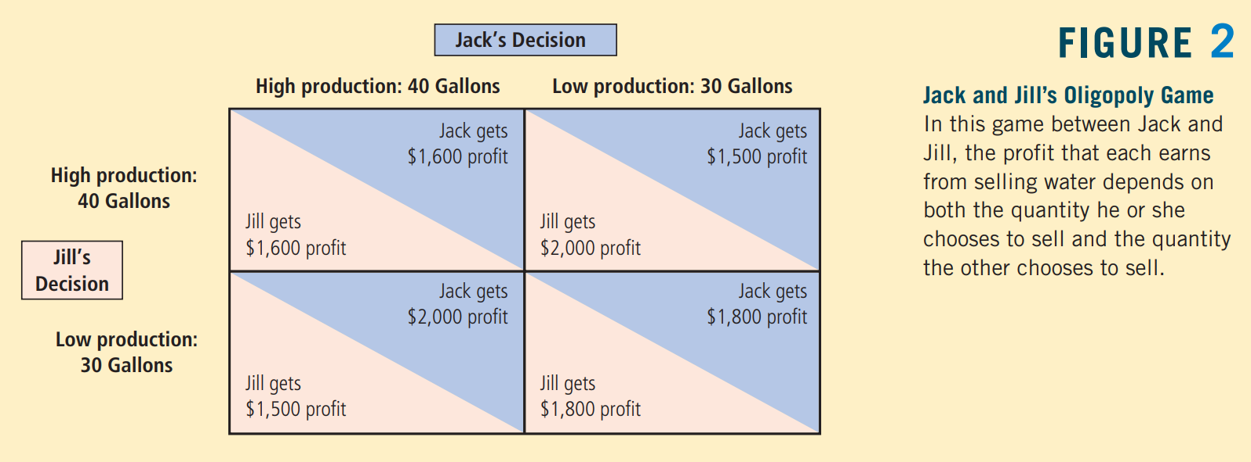

Slide 41
Case Study: OPEC and the World Oil Market
Our story about the town’s market for water is fictional, but if we change water to crude oil, and Jack and Jill to Iran and Iraq, the story is close to being true.
Much of the world’s oil is produced by a few countries, mostly in the Middle East. These countries together make up an oligopoly. Their decisions about how much oil to pump are much the same as Jack and Jill’s decisions about how much water to pump.
The countries that produce most of the world’s oil have formed a cartel, called the Organization of Petroleum Exporting Countries (OPEC). As originally formed in 1960, OPEC included Iran, Iraq, Kuwait, Saudi Arabia, and Venezuela. By 1973, eight other nations had joined: Qatar, Indonesia, Libya, the United Arab Emirates, Algeria, Nigeria, Ecuador, and Gabon. These countries control about three-fourths of the world’s oil reserves. Like any cartel, OPEC tries to raise the price of its product through a coordinated reduction in quantity produced. OPEC tries to set production levels for each of the member countries.

Slide 42
The problem that OPEC faces is much the same as the problem that Jack and Jill face in our story. The OPEC countries would like to maintain a high price for oil. But each member of the cartel is tempted to increase its production to get a larger share of the total profit. OPEC members frequently agree to reduce production but then cheat on their agreements.
OPEC was most successful at maintaining cooperation and high prices in the period from 1973 to 1985. The price of crude oil rose from $3 a barrel in 1972 to $11 in 1974 and then to $35 in 1981. But in the mid-1980s, member countries began arguing about production levels, and OPEC became ineffective at maintaining cooperation. By 1986 the price of crude oil had fallen back to $13 a barrel.
In recent years, the members of OPEC have continued to meet regularly, but they have been less successful at reaching and enforcing agreements. As a result, fluctuations in oil prices have been driven more by the natural forces of supply and demand than by the cartel’s artificial restrictions on production. While this lack of cooperation among OPEC nations has reduced the profits of the oil producing nations below what they might have been, it has benefited consumers around the world.

Slide 43
Other Examples of the Prisoners’ Dilemma
Arms Races:
In the decades after World War II, the world’s two superpowers— the United States and the Soviet Union—were engaged in a prolonged competition over military power. This topic motivated some of the early work on game theory. The game theorists pointed out that an arms race is much like the prisoners’ dilemma.
To see why, consider the decisions of the United States and the Soviet Union about whether to build new weapons or to disarm. Each country prefers to have more arms than the other because a larger arsenal would give it more influence in world affairs. But each country also prefers to live in a world safe from the other country’s weapons.
Figure 3 shows the deadly game. If the Soviet Union chooses to arm, the United States is better off doing the same to prevent the loss of power. If the Soviet Union chooses to disarm, the United States is better off arming because doing so would make it more powerful. For each country, arming is a dominant strategy. Thus, each country chooses to continue the arms race, resulting in the inferior outcome with both countries at risk.

Slide 44
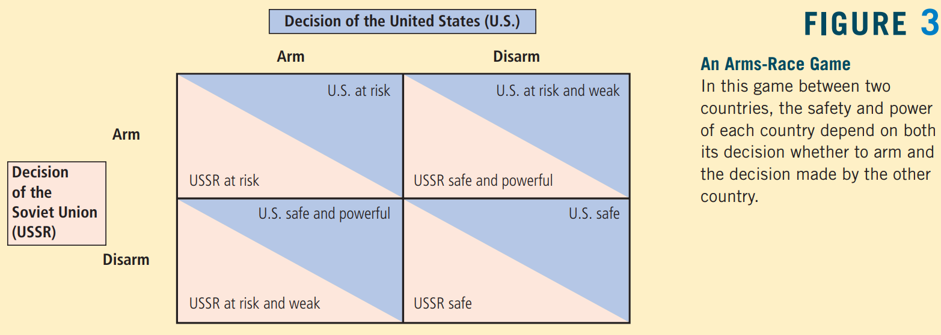
And just as cartels have trouble enforcing production levels, the United States and the Soviet Union each feared that the other country would cheat on any agreement. In both arms races and oligopolies, the relentless logic of self-interest drives the participants toward the noncooperative outcome, which is worse for both parties.

Slide 45
Common Resources:
People tend to overuse common resources. One can view this problem as an example of the prisoners’ dilemma.
Imagine that two oil companies—Exxon and Texaco—own adjacent oil fields. Under the fields is a common pool of oil worth $12 million. Drilling a well to recover the oil costs $1 million. If each company drills one well, each will get half of the oil and earn a $5 million profit ($6 million in revenue minus $1 million in costs).
Because the pool of oil is a common resource, the companies will not use it efficiently. Suppose that either company could drill a second well. If one company has two of the three wells, that company gets two-thirds of the oil, which yields a profit of $6 million. The other company gets one-third of the oil, for a profit of $3 million. Yet if each company drills a second well, the two companies again split the oil. In this case, each bears the cost of a second well, so profit is only $4 million for each company.

Slide 46
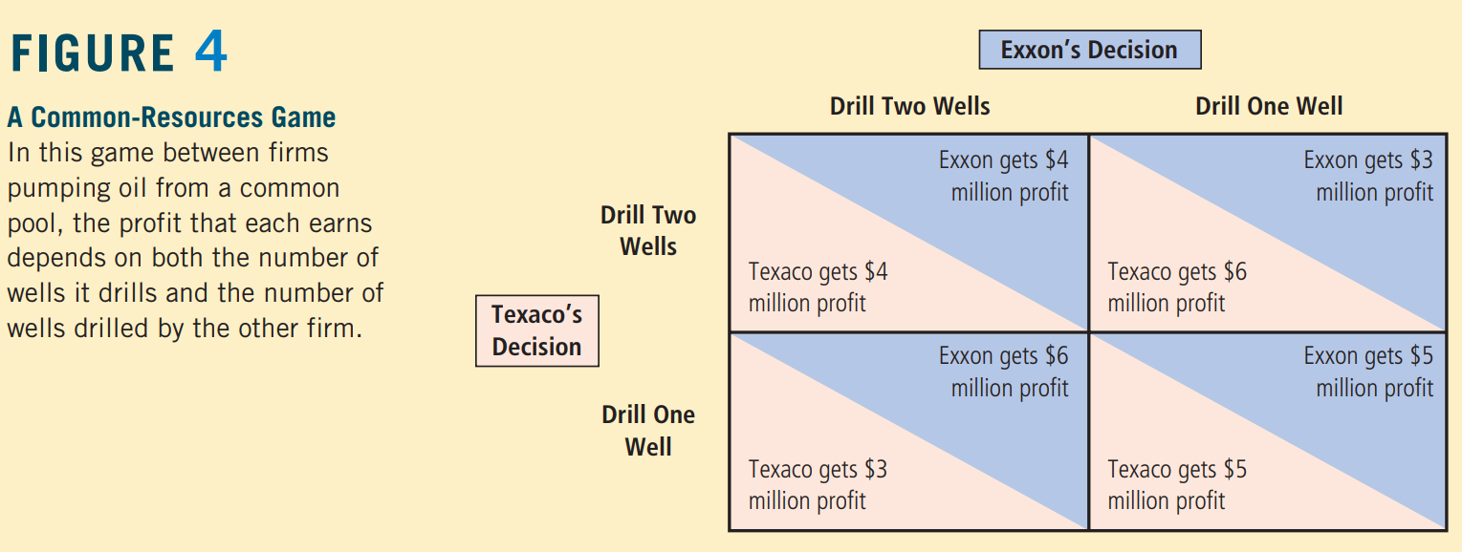
Figure 4 shows the game. Drilling two wells is a dominant strategy for each company. Once again, the self-interest of the two players leads them to an inferior outcome.

Slide 47
The Prisoners’ Dilemma and the Welfare of Society
The prisoners’ dilemma describes many of life’s situations, and it shows that cooperation can be difficult to maintain, even when cooperation would make both players in the game better off.
But is lack of cooperation a problem from the standpoint of society as a whole? The answer depends on the circumstances.
In some cases, the noncooperative equilibrium is bad for society as well as the players, as in the arms-race game in Figure 3, & in the common-resources game in Figure 4. In both cases, society would be better off if the two players could reach the cooperative outcome.
By contrast, in the case of oligopolists trying to maintain monopoly profits, lack of cooperation is desirable from the standpoint of society as a whole. The monopoly outcome is good for the oligopolists, but it is bad for the consumers of the product.
The competitive outcome is best for society because it maximizes total surplus. When oligopolists fail to cooperate, the quantity they produce is closer to this optimal level.
Put differently, the invisible hand guides markets to allocate resources efficiently only when markets are competitive, and markets are competitive only when firms in the market fail to cooperate with one another.
Similarly, consider the case of the police questioning two suspects. Lack of cooperation between the suspects is desirable, for it allows the police to convict more criminals. The prisoners’ dilemma is a dilemma for the prisoners, but it can be a boon to everyone else.

Slide 48
Why People Sometimes Cooperate?
The prisoners’ dilemma shows that cooperation is difficult. But is it impossible? Not all prisoners, when questioned by the police, decide to turn in their partners in crime.
Cartels sometimes manage to maintain collusive arrangements, despite the incentive for individual members to defect. Very often, players can solve the prisoners’ dilemma because they play the game not once but many times.
To see why cooperation is easier to enforce in repeated games, let’s return to our duopolists, Jack and Jill, whose choices were given in Figure 2. Jack and Jill would like to agree to maintain the monopoly outcome in which each produces 30 gallons. Yet, if Jack and Jill are to play this game only once, neither has any incentive to live up to this agreement. Self-interest drives each of them to renege and choose the dominant strategy of 40 gallons.
Now suppose that Jack and Jill know that they will play the same game every week. When they make their initial agreement to keep production low, they can also specify what happens if one party reneges. They might agree, for instance, that once one of them reneges and produces 40 gallons, both of them will produce 40 gallons forever after. This penalty is easy to enforce, for if one party is producing at a high level, the other has every reason to do the same.
The threat of this penalty may be all that is needed to maintain cooperation. Each person knows that defecting would raise his or her profit from $1,800 to $2,000. But this benefit would last for only one week. Thereafter, profit would fall to $1,600 and stay there. As long as the players care enough about future profits, they will choose to forgo the one-time gain from defection. Thus, in a game of repeated prisoners’ dilemma, the two players may well be able to reach the cooperative outcome.

Slide 49
Public Policy toward Oligopolies
Cooperation among oligopolists is undesirable from the standpoint of society as a whole because it leads to production that is too low and prices that are too high. To move the allocation of resources closer to the social optimum, policymakers should try to induce firms in an oligopoly to compete rather than cooperate.
Restraint of Trade and the Antitrust Laws
One way that policy discourages cooperation is through the common law. Normally, freedom of contract is an essential part of a market economy. Businesses and households use contracts to arrange mutually advantageous trades. In doing this, they rely on the court system to enforce contracts.
Yet, for many centuries, judges in England and the United States have deemed agreements among competitors to reduce quantities and raise prices to be contrary to the public good. They have therefore refused to enforce such agreements.
The Sherman Antitrust Act of 1890
The Clayton Act of 1914

Slide 50
Today, both the U.S. Justice Department and private parties have the authority to bring legal suits to enforce the antitrust laws.
These laws are used to prevent mergers that would lead to excessive market power in any single firm.
In addition, these laws are used to prevent oligopolists from acting together in ways that would make their markets less competitive.

Slide 51
Predatory Pricing
Firms with market power normally use that power to raise prices above the competitive level.
But should policymakers ever be concerned that firms with market power might charge prices that are too low?
Imagine that a large airline, call it Indigo Air, has a monopoly on some route. Then SpiceJet Express enters and takes 20 percent of the market, leaving Indigo Air with 80 percent. In response to this competition, Indigo Air starts slashing its fares. Some antitrust analysts argue that Indigo Air’s move could be anticompetitive: The price cuts may be intended to drive SpiceJet Express out of the market so Indigo Air can recapture its monopoly and raise prices again. Such behavior is called predatory pricing.

Slide 52
Conclusion
Oligopolies would like to act like monopolies, but self-interest drives them toward competition. Where oligopolies end up on this spectrum depends on the number of firms in the oligopoly and how cooperative the firms are. The story of the prisoners’ dilemma shows why oligopolies can fail to maintain cooperation, even when cooperation is in their best interest.
Policymakers regulate the behavior of oligopolists through the antitrust laws. The proper scope of these laws is the subject of ongoing controversy. Although price fixing among competing firms clearly reduces economic welfare and should be illegal, some business practices that appear to reduce competition may have legitimate if subtle purposes. As a result, policymakers need to be careful when they use the substantial powers of the antitrust laws to place limits on firm behavior.

Slide 53
